Slide 1

Week #4
AI Academy®
1
Day 1:
What is JavaScript?
JavaScript Output Statements
JavaScript Variable Types and Difference
Reviews & Feedbacks

Slide 2
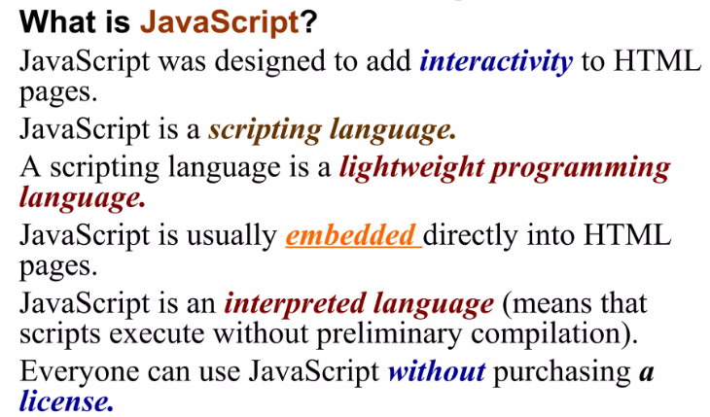
Week #4
AI Academy®
2

Slide 3
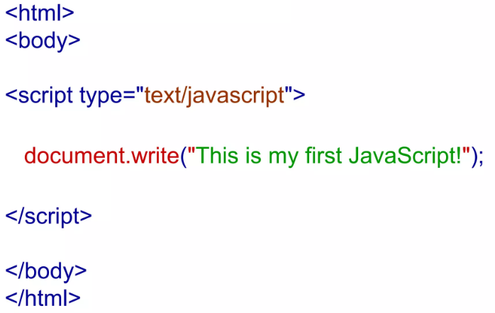
Week #4
AI Academy®
3

Slide 4
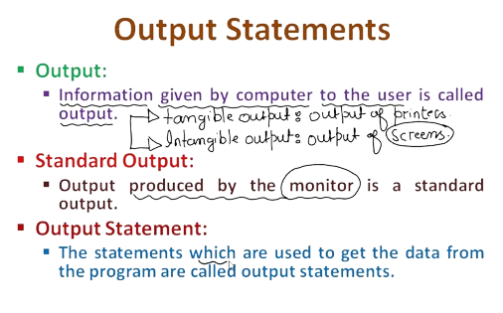
Week #4
AI Academy®
4

Slide 5
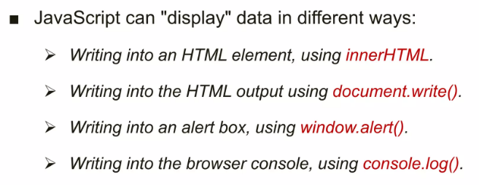
Week #4
AI Academy®
5

Slide 6

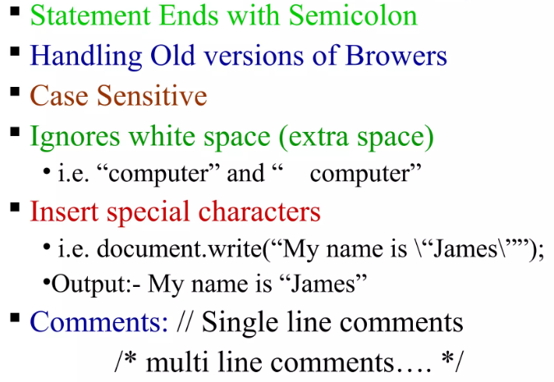
Week #4
AI Academy®
6

Slide 7

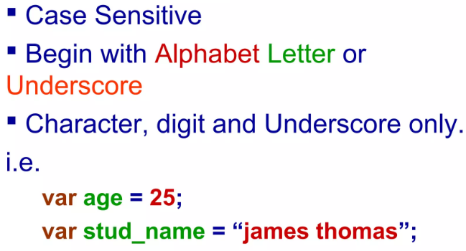
Week #4
AI Academy®
7

Slide 8
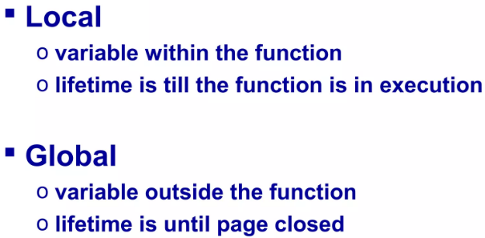
Week #4
AI Academy®
8

Slide 9

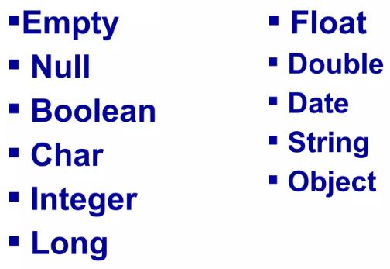
Week #4
AI Academy®
9

Slide 10
Week #4
AI Academy®
10
Day 2:
JavaScript Operators
Conditional Statements
Reviews & Feedbacks

Slide 11
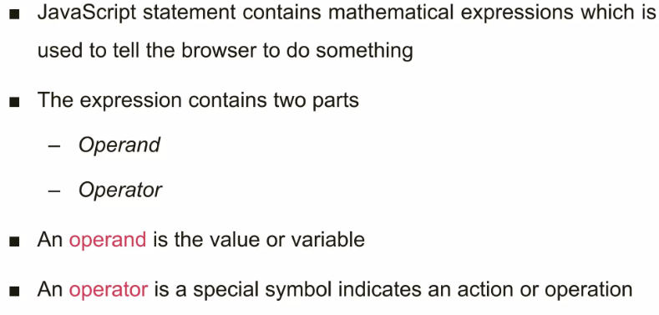
Week #4
AI Academy®
11

Slide 12
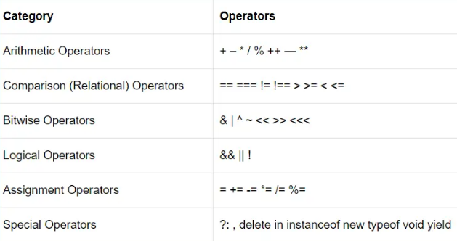
Week #4
AI Academy®
12

Slide 13
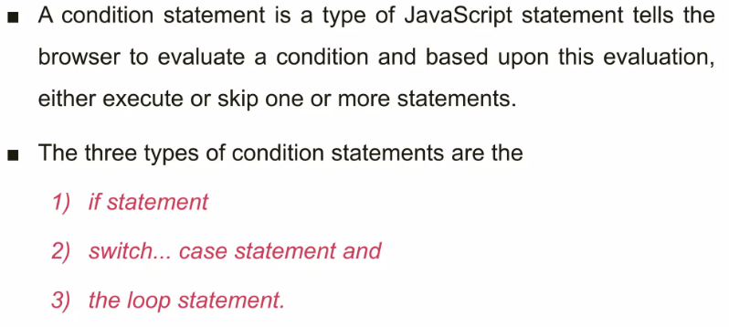
Week #4
AI Academy®
13

Slide 14
Week #4
AI Academy®
14
Day 3:
Loops:
For Loop
While Loop
Do While Loop
Reviews & Feedbacks

Slide 15

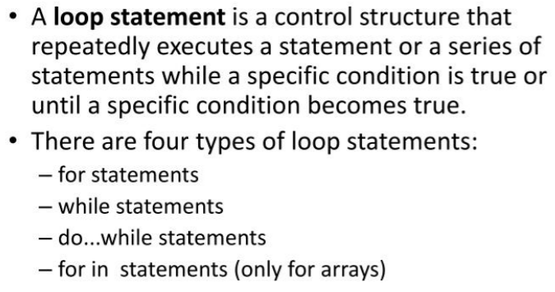
Week #4
AI Academy®
15

Slide 16

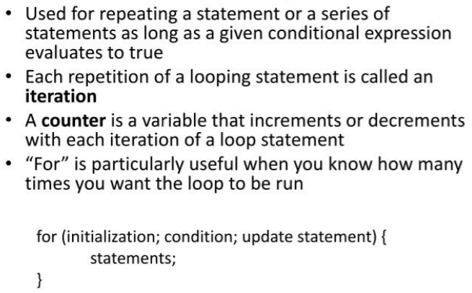
Week #4
AI Academy®
16

Slide 17

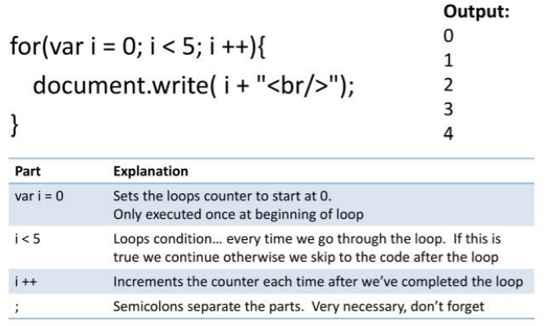
Week #4
AI Academy®
17

Slide 18

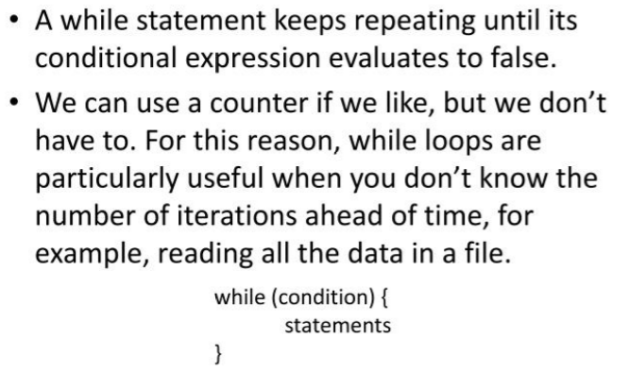
Week #4
AI Academy®
18

Slide 19

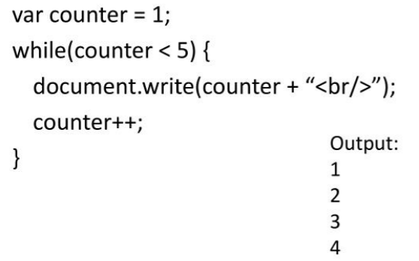
Week #4
AI Academy®
19

Slide 20

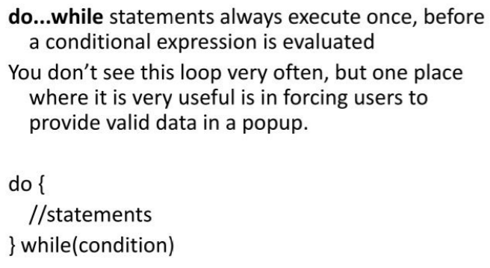
Week #4
AI Academy®
20

Slide 21

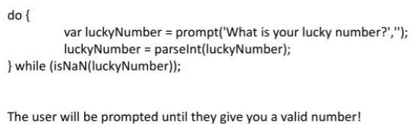
Week #4
AI Academy®
21

Slide 22
Week #4
AI Academy®
22

Slide 23
Week #4
AI Academy®
23
Day 4:
JavaScript Functions
Function Types
Difference Between Functions and Class
Reviews & Feedbacks

Slide 24
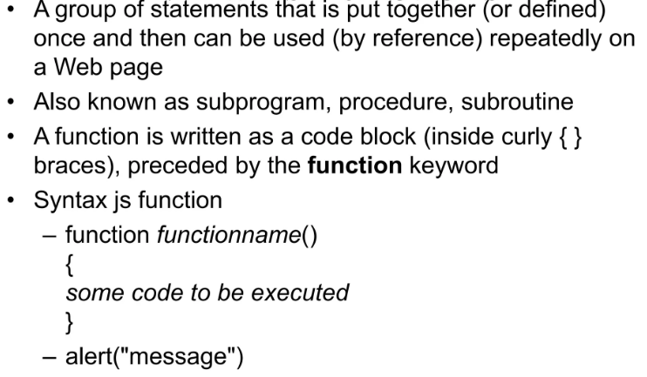
Week #4
AI Academy®
24

Slide 25


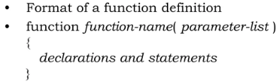
Week #4
AI Academy®
25

Slide 26
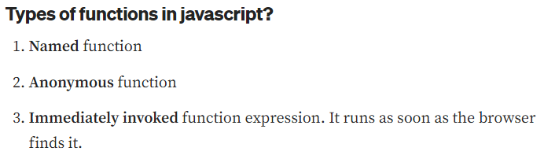
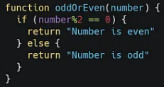
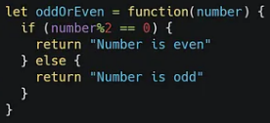
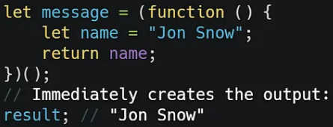
Week #4
AI Academy®
26

Slide 27
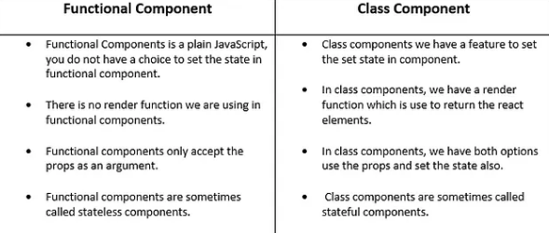
Week #4
AI Academy®
27

Slide 28
Week #4
AI Academy®
28
Day 5:
JavaScript Objects
JavaScript Arrays
Difference
Reviews & Feedbacks

Slide 29
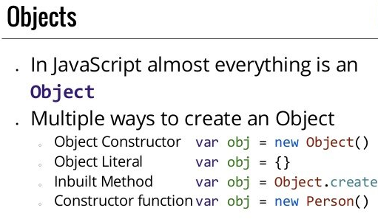
Week #4
AI Academy®
29

Slide 30
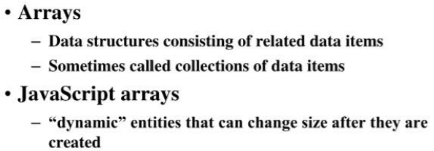
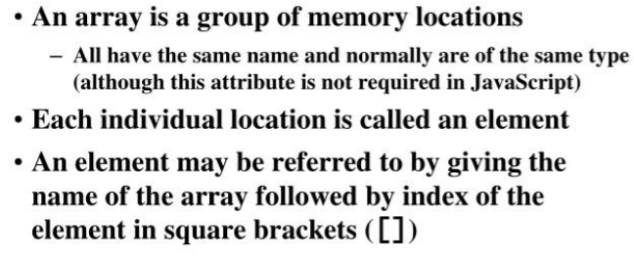
Week #4
AI Academy®
30

Slide 31
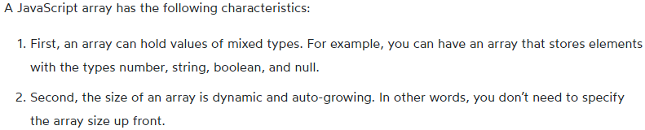
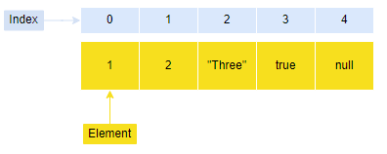
Week #4
AI Academy®
31

Slide 32
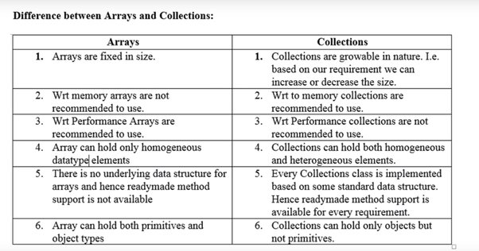
Week #4
AI Academy®
32

